Slide 1
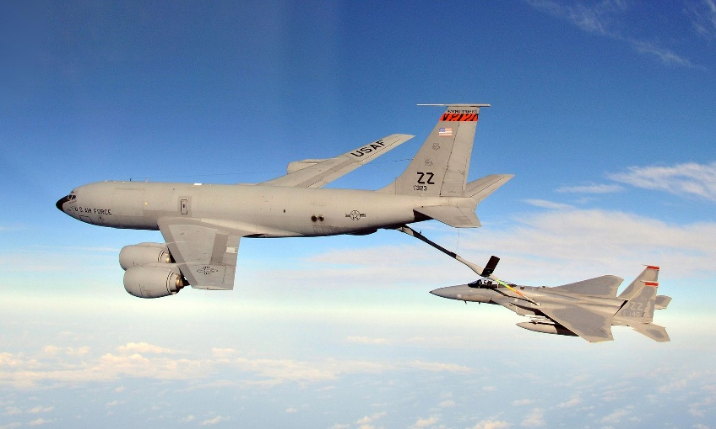
Mr. Thomas – Spring 2025 Refuel/Jet Lag and Office Hours Schedule
Refuel / Jet Lag Schedule
Monday, Wednesday, Friday
1145-1215
Tuesday & Thursday – not available
Office Hours
Tuesday, Thursday
0715-0800
Other times by appointment

